Slide 1
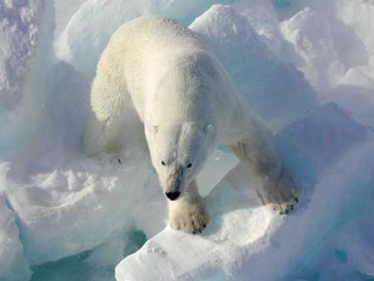
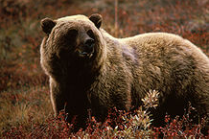
Race ≠Racism
Racism ≠ Ethnocentrism

Slide 2
There is a legitimate place for the concept of race in biology; indeed it is important for conservation of wildlife
Species: organisms that breed with each other, but not with others
Polar bear (Ursus maritimus ) Brown bear, (Ursus arctos)

Slide 3
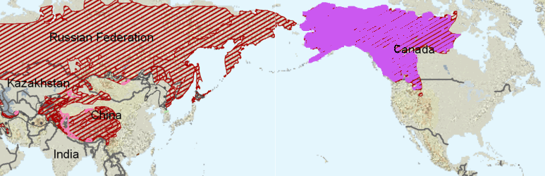
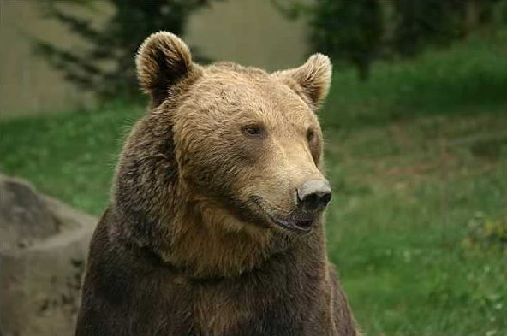
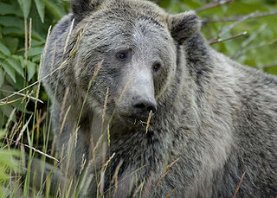
Race: Same species, potential to breed with each other, but geographic separation created “enough” genetic distinction for a sub-species.
Ursus arctos arctos – Eurasian brown bear Grizzly bear (Ursus arctos horribulus)

Slide 4
“Race” in humans
Race would require that humans can be distinguished by phenotypic characteristics that reflect “enough” genetic differences corresponding to geographically distinct ancestral origins.

Slide 5
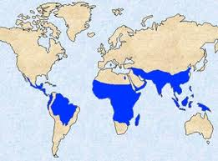
“Race” in humans: are we sub-species?
We do have genetic differences, but they are very small compared to those of other species
Even the legitimate cases of genetic differences don’t seem very stable
Example: the genes for sickle cell anemia match the geographic location of malaria. Homozygotes for sickle cell is often fatal, but heterozygotes gives immunity against malaria. But these genes rapidly decrease in the population in the absence of malaria. Is that race?

Slide 6
1. Belief in human races
2. Belief that race is a significant determinant of (ranked) ability
∴ Not all those who believe in “Race” are racists (eg most abolitionists.)
Appiah: distinction between 'racialism' and 'racism'
Racism requires

Slide 7
Generally, Race = biology and Ethnicity = culture
Ethnocentric: Belief that culture is a significant determinant of (ranked) ability
One can be ethnocentric without being racist: “if those Arabs would just convert to Christianity we wouldn’t have a problem”
Ramán Grosfoguel argues against: 'racialized ethnicities' (“jewish racial stereotypes”) and 'ethnicized races’ (above quote ignores Christian Arabs) indicates 'racial/ethnic identity' operates as one system

