Slide 1
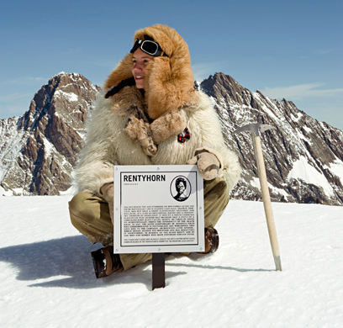
A brief genealogy of race

Slide 2
Biology as a primary distinction of human groups (“race”) is new
Ancient Greek: Greek’s have city-state, Barbarians do not.
Roman: Barbarians outside legal structure of the empire
Medieval: Christian vs non-Christian
16th century Spain/Portugal: African and Native American enslavement debated in terms of “race” (term from dog breeding*)
*de Miramon, Charles. 2009. “Noble Dogs, Noble Blood: The Invention of the Concept of Race in the Late Middle Ages.” In The Origins of Racism in the West, ed. Miriam Eliav-Feldon, Benjamin Isaac, and Joseph Ziegler, 200–216. 1st ed. Cambridge University Press.
Notes:
The Invention of Racism in Classical Antiquity (B. Shaw 2004)

Slide 3
Rise of race simultaneous with rise of colonialism
1684 publication of “A New Division of the Earth” by Francois Bernier (proposes 5 races)
1758, Linnaeus proposed four “subcategories” of Homo sapiens: Americanus; Asiaticus; Africanus; and Europeanus
18th century: monogenist position (Kant, Blumenbach) vs polygenist (Agassiz, Gliddon, Nott)

Slide 4
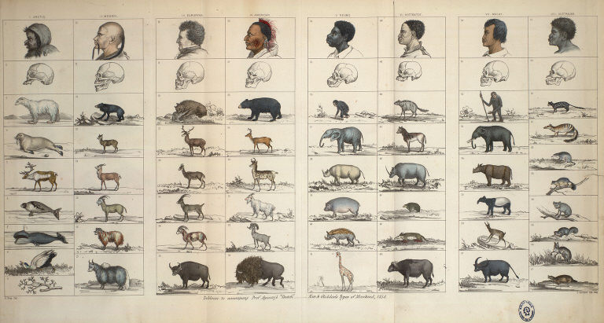
Polygenesis
Nott and Gliddon, Types of Mankind (1850)

Slide 5
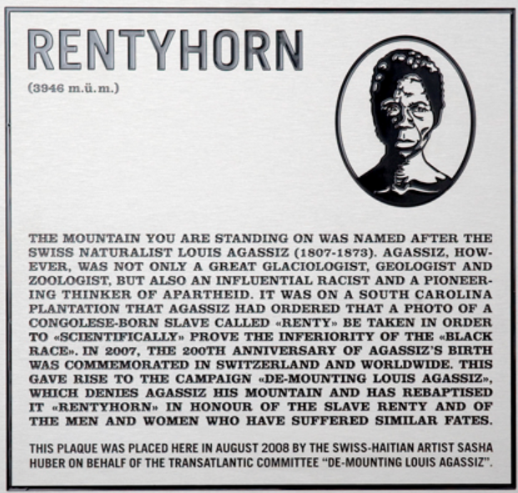
Louis Agassiz: photographs black slaves (such as “Renty”) as evidence of white genetic superiority,
Mt Agassiz named for him.
Haitian-Swiss artist Sasha Huber,
“de-mounting Agassiz”

Slide 6
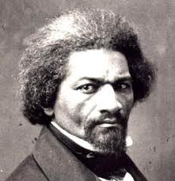
1854: Frederick Douglass "The Claims of the Negro, Ethnologically Considered"
"the debates in Congress on the Nebraska Bill during the past winter, will show how slaveholders have availed themselves of this doctrine [multiple creations] in support of slaveholding. There is no doubt that the Messrs. Nott, Glidden [sic], Morton, Smith and Agassiz were duly consulted by our slavery propagating statesmen" (p. 16).
U.S. Secretary of State John C. Calhoun: annexation of Texas as a slave state justified by Samuel George Morton’s Crania Americana (1839)

Slide 7
1854:
example of sociology of institutions in STS: rather than “rational economic actor” analysis though schemas, norms, routines, etc. (Foucault’s dispositif )
1994:
Science | Government
Morton → | Calhoun
Science | “Think tank” | Government
Herrnstein and Murray “The Bell Curve” (Rushton, Jensen, Burt, etc.) | American Enterprise Institute | Newt Gingrich (former House Speaker), and Kevin Hassett, (economic advisor to Bush and McCain), etc.

Slide 8
1845: “The [white] slaver has debased his Nature & violates every best instinctive feeling by making slave of his fellow black.”
Frederick Douglass
Harriet Tubmann
Sojourner Truth

Slide 9
Charles Darwin, Abolitionist
1845: “The [white] slaver has debased his Nature & violates every best instinctive feeling by making slave of his fellow black.”
Grandfather -- Society for Effecting the Abolition of the Slave Trade;
Uncle -- entered parliament on abolitionist platform;
Aunt -- donated to anti-slavery societies
Taxidermy instructor -- John Edmonstone, a freed black slave
Darwin opposed the racist view that Africans, Native American etc. were “separate acts of creation”
Adrian Desmond and James Moore: The theory of evolution was inspired by the need for a scientific basis for the abolitionist contention that there is ONE HUMAN SPECIES from a single origin
(Bonus question: which STS theory would best account for this?)

Slide 10
Haraway, “Teddy Bear Patriarchy”
1921: The Second International Conference on Eugenics
American Museum of Natural History (NYC)
“Eugenics and conservation were closely linked in philosophy and in personnel at the Museum,
and they tied in closely with exhibition and research. For example, the white-supremacist author
of “The Passing of the Great Race,” Madison Grant, was… a co-founded of the California Save-The-Redwoods-League, an activist for… national parks, and secretary of the New York Zoological Society”

Slide 11

United Nations Educational, Scientific and Cultural Organization (UNESCO) statement on Race
1950: “Because serious errors of this kind are habitually committed when the term ‘race’ is used in popular parlance, it would be better when speaking of human races to drop the term ‘race’ altogether and speak of ethnic groups.“ (Levi-Strauss, Ashley Montagu, etc.)
After criticism from biologists
1951 “The concept of race is unanimously regarded by anthropologists as a classificatory device providing a zoological frame within which the various groups of mankind may be arranged and by means of which studies of evolutionary processes can be facilitated. [However] overall, available scientific knowledge provides no basis for believing that the groups of mankind differ in their innate capacity for intellectual and emotional development.” (Dobzhansky, Huxley, etc.)

Slide 12
United Nations Educational, Scientific and Cultural Organization (UNESCO) statement on Race
1954 UNESCO quoted in Supreme Court desegregation "Brown v. Board of Education“
1956 Republic of South Africa withdraws from UNESCO, citing “interference with our race problem” (returns in 1994 under Mandela)
1970: UNESCO in the Republic of Mali brings Brazilian mathematician Ubiratan D’Ambrosio, who founds “ethnomathematics” as anti-racist intellectual stance and activist practice

Slide 13

From Genetics to Genomics
Human Genome Diversity Project
Direct to Consumer Ancestry Testing
DNA Forensics
Race-based Medicine
Epigenetics

Slide 14
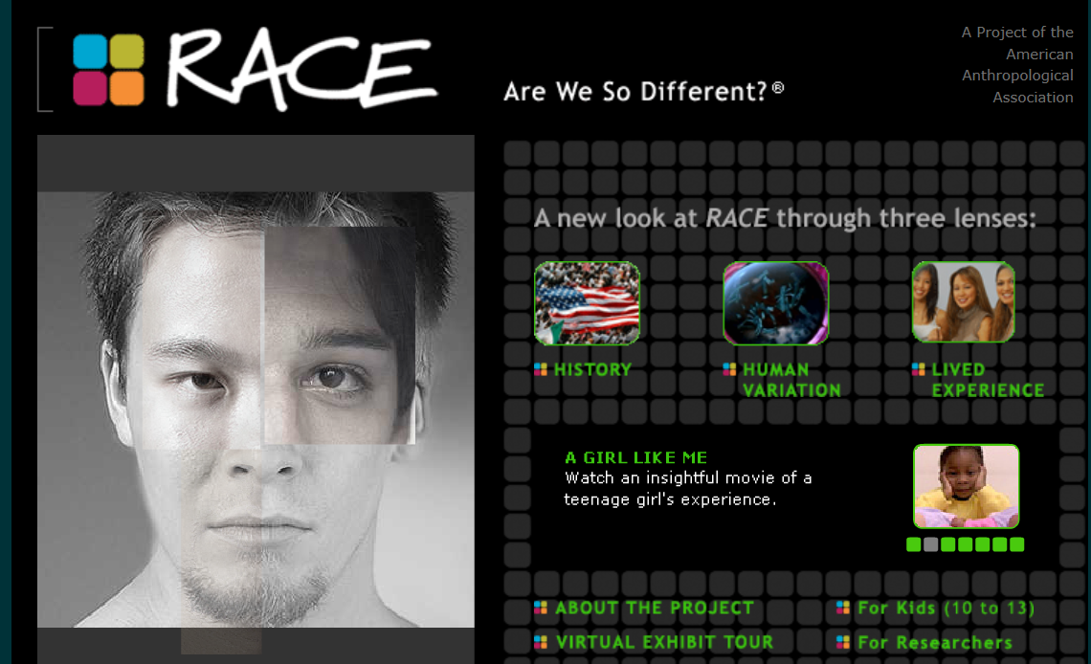
American Anthropological Association

